Slide 1
Module 2: Intro to Docker
Srikanth Sureddy, Sr. Escalation Engineer – Embedded Escalation Engineer

Slide 2
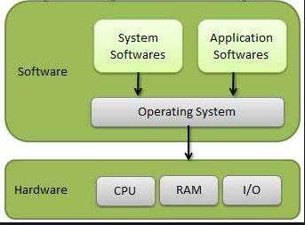
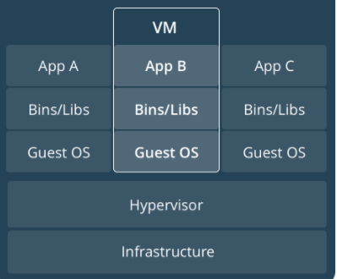
Introduction to Containers
A step back to how we used to deploy:

Slide 3
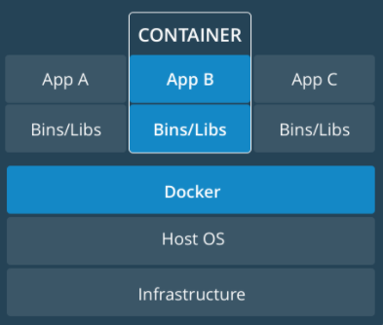
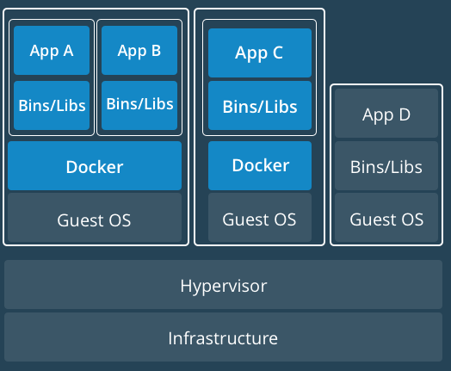
Introduction to Containers (Continued)
Deploying with Containers
Single Host VM-based

Slide 4
What is a Container?
Software that encapsulates code, runtime, system tools/libraries, and settings.
Build once and run anywhere, regardless of underlying OS.
Isolate applications from one another and underlying infrastructure.
Very secure to run.
Most popular container is Docker.
A couple of others are Rkt and Garden.

Slide 5
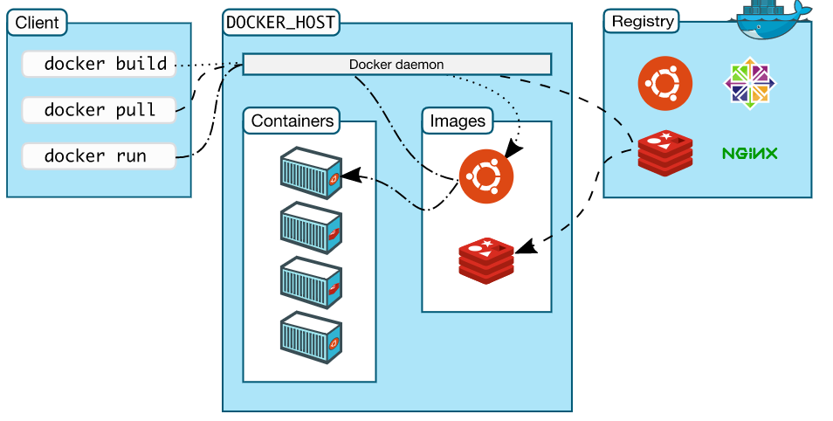
Docker
Most popular and used platform for developing, shipping and running containers
Components that enable Docker
Client (docker cli)
Docker Host
Daemon
Containers
Images
Registry (Image repository)

Slide 6
Docker (continued)
Uses Go Language
Each container has these namespaces:
Process isolation (pid)
Networking (net)
Inter-process communication (ipc)
File system mounts (mnt)
Kernel and version identifiers (uts)
Control Groups
Limit an application to a specific set of resources.
Union File Systems
File systems that operate by creating layers, making them very fast.

